Slide 1
Fitness Friend
A Modern Approach to Fitness
Group 6 Team Members: Amber Haynes, Tiyon King, Jenna Krause, Mya Odrick, Devvrat Patel, Andrew Rezk, Maria Rios, Shivani Sunil, Hedaya Walter

Slide 2
Background
Fitness Friend was created due to the findings that owners of smart watches have a lower level of physical activity than non-owners.
Fitness watches show calories lost through regular, daily movement. It gives the illusion that users are losing weight.
The app aims to overcome this by providing motivational features to encourage users to work out and make goals.

Slide 3
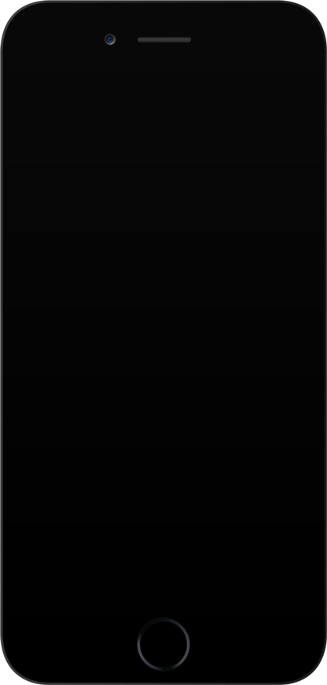
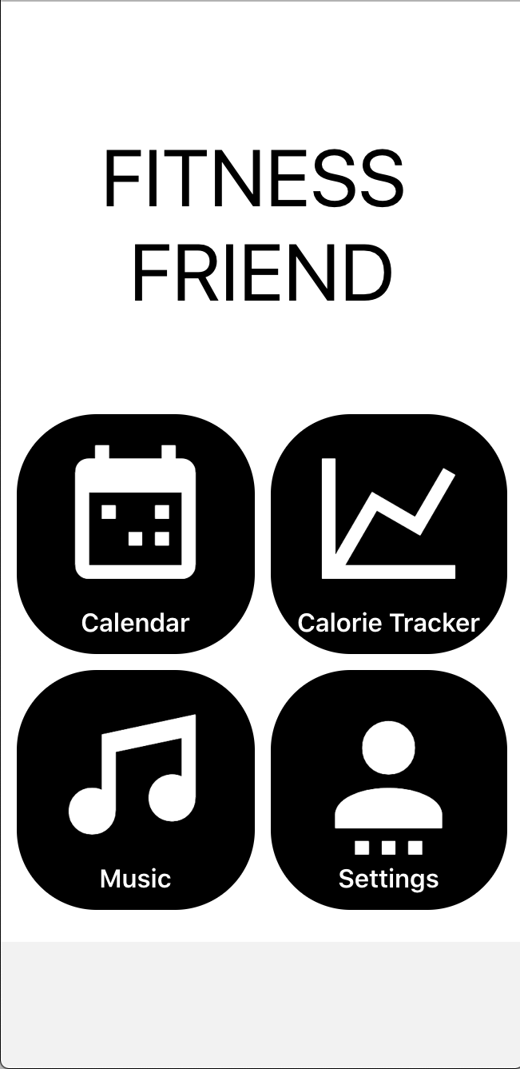
Features
Calendar Sync
The calendar sync feature syncs with the user’s Google Calendar to seek out any free time that may be available during the day. The feature would notify the user and suggest that a workout during this time for a predetermined interval length.
Calorie Tracker & Exercise Selector
The calorie tracker allows the user to log their calories and update their calorie goals. The user can look up how many calories are in their meals or how many calories are burned during their workout.
Music Curator
The music curator provides the user with BPM based playlists, via the integration of the Spotify through SDKs and APIs, to add to the overall motivational aspect of fitness. The playlists generate are based on user selected artists as well as type of workout selected.

Slide 4
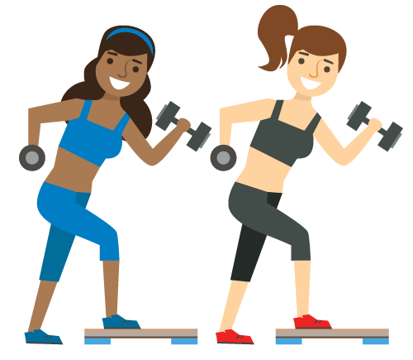
Who It’s For
Target Audience: Smartphone Owners
People who lack motivation to workout
People with busy daily schedules
People who want to better themselves physically
People who want to monitor what’s going into their body
This app works on all smartphones but there are added benefits
for those who also have smartwatches.

Slide 5
Roadmap
Algorithm Development
February
March
April
Week 2-3
Week 4
Week 5
Week 6
Week 7
Week 8-9
Week 10
Week 11-12
Week 13-14
User Interface Design
API & Database Unification
Code Integration
Testing and Debugging

